Slide 1


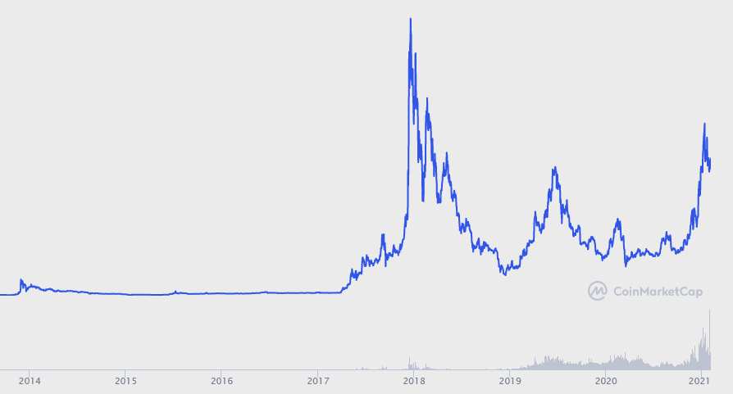
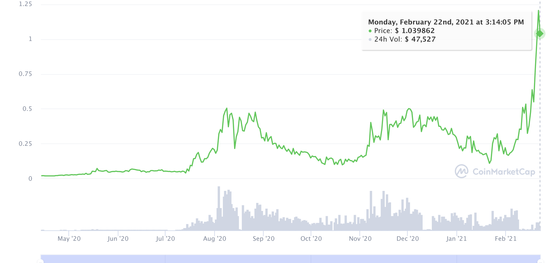
CRYPTO SILVER
THE RACE TO BE A MEDIUM OF EXCHANGE
CURRENT SUPPLY
66.4m
10.6M
MAX SUPPLY
84M
21M
PRICE
$141.19
$1.03
MARKET CAP
CHART?
SPEED
2.5 minute
block interval
1 minute
block interval
FEE
2 cents / tx
$.00025
40 transactions
for 1 cent
Can validate entire chain on low-end smartphone
SCALABILITY
/BLOCKCHAIN SIZE
1.3GB
47.5GB
PRIVACY
Optional privacy
coming 2021
100% transactions invisible
MINING
ASIC
GPU
CPU
MOBILE
2021
Crypto Silver - the race to be a medium of exchange 22nd Feb 2021 v05

